Slide 1

Veteran Anxiety
Garrett Fiorito, Samia Mohamed, Ian Bradley, Ramadan Abdulsalaam

Slide 2
Introduction
National Veterans Health Equity Report
Over 5 million veterans patient reports
Compares demographics (age, race, sex, etc.)

Slide 3
Overview
SQL queries and results
Data Visualizations
Data cleaning
Conclusions

Slide 4
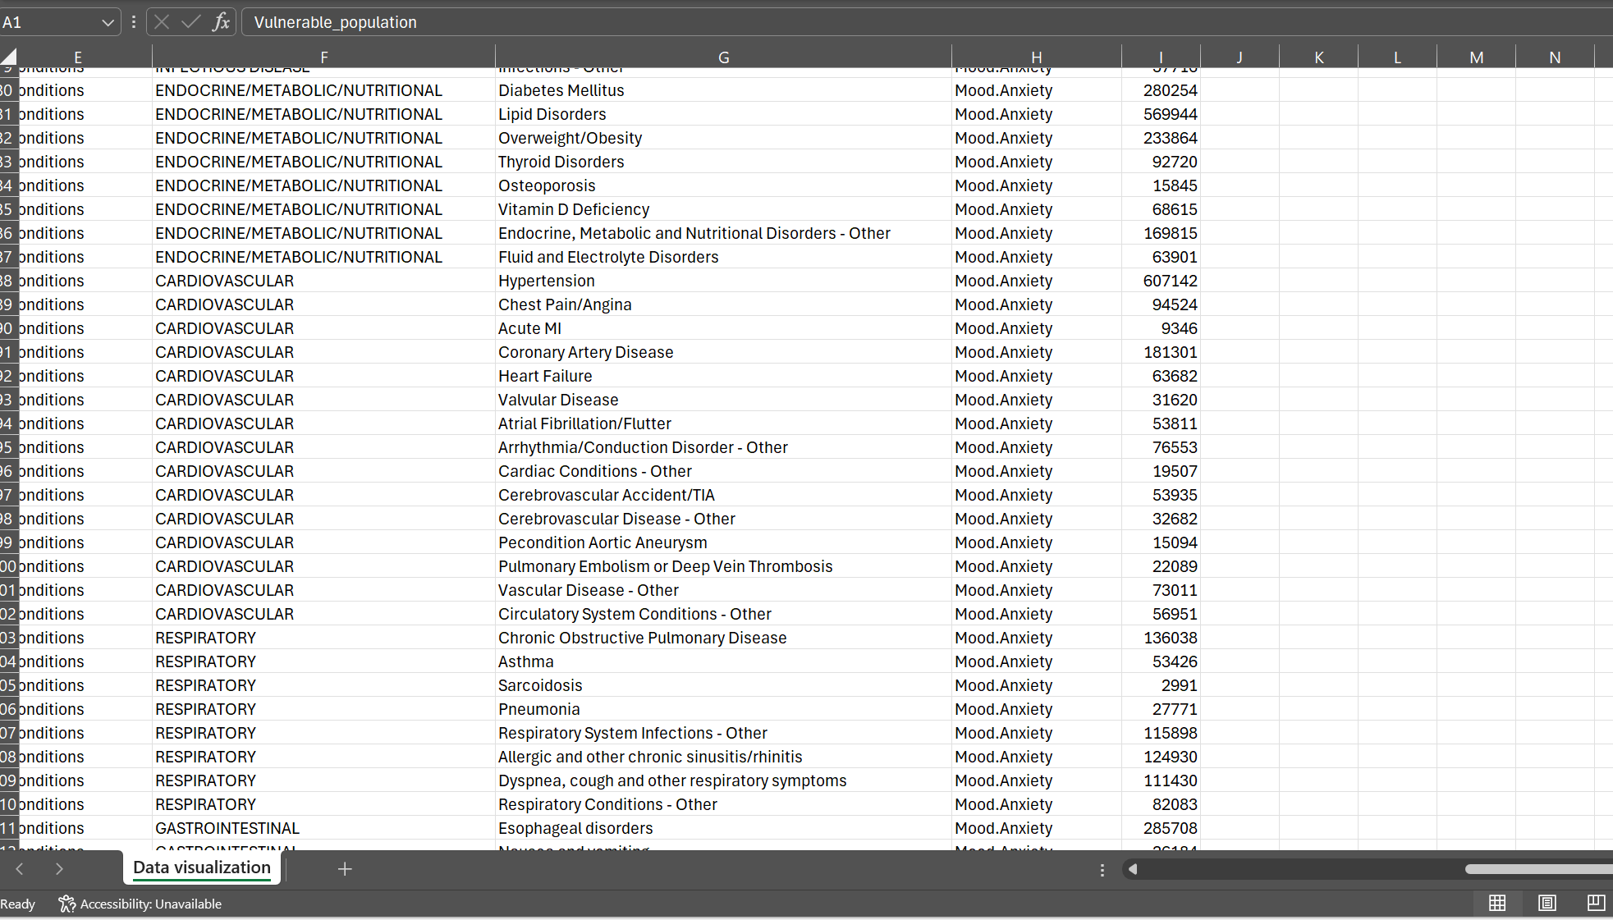
Data Cleaning
Substance abuse
Other disorders/diseases
No reported case of an anxiety disorder

Slide 5
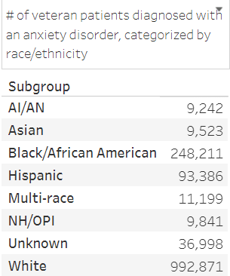
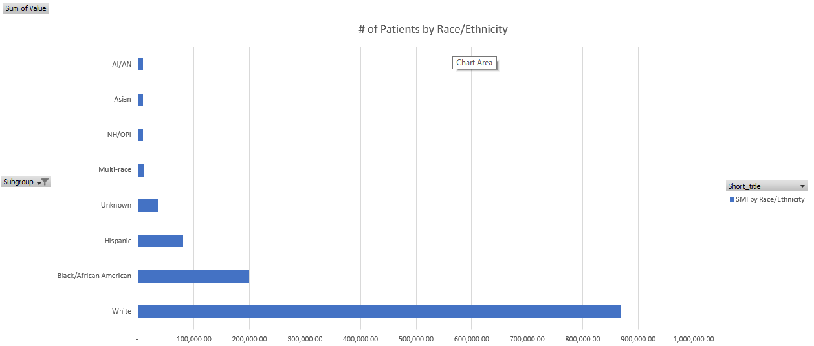
Research Question 1
What race in veteran patients reported the most cases of an anxiety disorder?
Created with Tableau

Slide 6
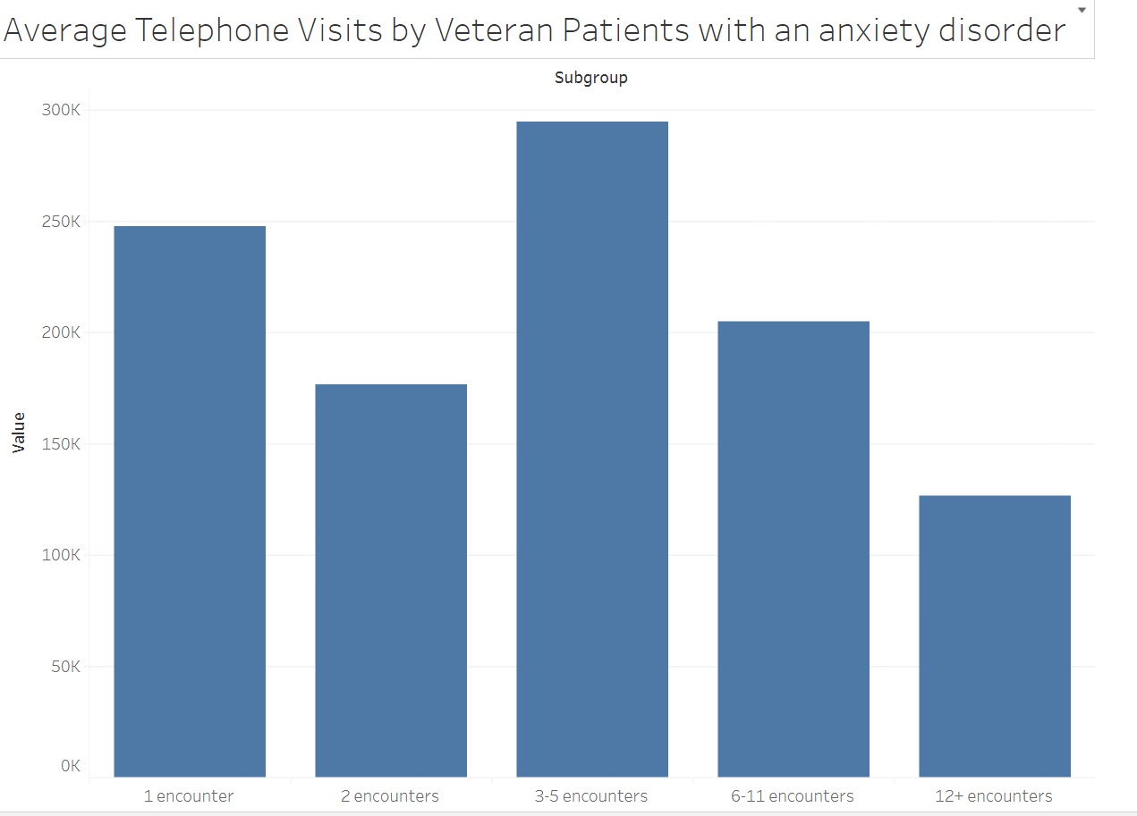
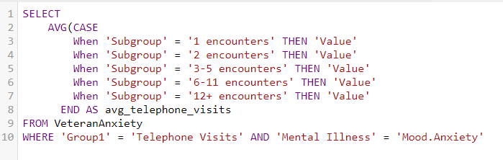
Research Question 2
What were the maximum and minimum phone encounters for all anxiety patient?
Created with Tableau

Slide 7
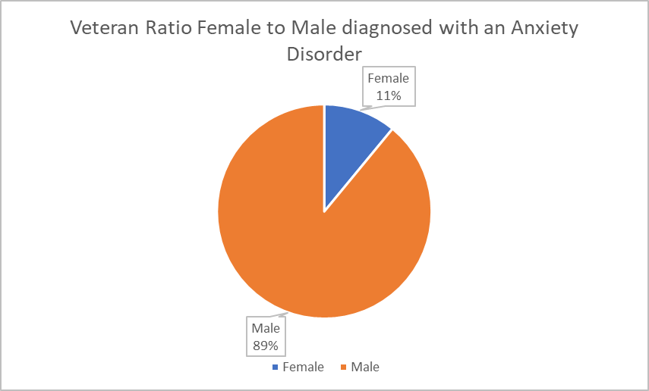
Research Question 3
What is the ratio between Veteran female and male patients diagnosed with an anxiety disorder?

Slide 8
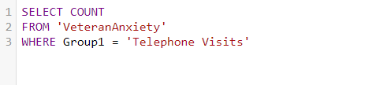
Research Question 4
How many total telephone visits were recorded for patients?
1,411,271

Slide 9
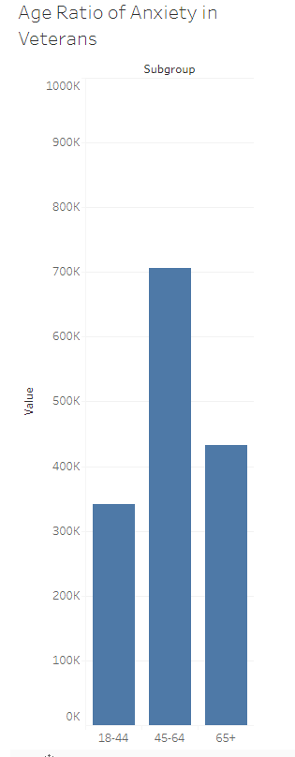
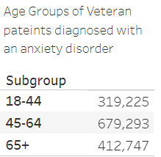
Research Question 5
What age group of Veteran patients had reported the most cases of an anxiety disorder?
Created with Tableau
Created with Tableau

Slide 10
Conclusion
Veterans ages 45-64 reported most cases
Most patients had 3-5 encounters with physician
89% of male patients were diagnosed with an anxiety disorder

